Slide 1
FATTY ACID OXIDATION

Slide 2
FATTY ACIDS
A fatty acid contains a long hydrocarbon chain and a terminal carboxylate group. The hydrocarbon chain may be saturated (with no double bond) or may be unsaturated (containing double bond).

Slide 3
FUNCTIONS OF FATTY ACIDS
Fatty acids have four major physiological roles.
Fatty acids are building blocks of phospholipids and glycolipids.
Many proteins are modified by the covalent attachment of fatty acids, which target them to membrane locations
Fatty acids are fuel molecules. They are stored as triacylglycerols. Fatty acids mobilized from triacylglycerols are oxidized to meet the energy needs of a cell or organism.
Fatty acid derivatives serve as hormones and intracellular messengers e.g. steroids, sex hormones and prostaglandins. TRIGLYCERIDES  Triglycerides are a highly concentrated stores of energ

Slide 4
TRIGLYCERIDES
Triglycerides are a highly concentrated stores of energy because they are reduced and anhydrous.
 The yield from the complete oxidation of fatty acids is about 9 kcal g-1 (38 kJ g-1)
 Triacylglycerols are nonpolar, and are stored in a nearly anhydrous form, whereas much more polar proteins and carbohydrates are more highly

Slide 5
TRIGLYCERIDES V/S GLYCOGEN

Slide 6
TYPES OF FATTY ACID OXIDATION
Fatty acids can be oxidized by
Beta oxidation- Major mechanism, occurs in the mitochondria matrix. 2-C units are released as acetyl CoA per cycle.
Alpha oxidation- Predominantly takes place in brain and liver, one carbon is lost in the form of CO2 per cycle.
Omega oxidation- Minor mechanism, but becomes important in conditions of impaired beta oxidation
Peroxisomal oxidation- Mainly for the trimming of very long chain fatty acids

Slide 7
BETA OXIDATION
Overview of beta oxidation
A saturated acyl Co A is degraded by a recurring sequence of four reactions:
1) Oxidation by flavin adenine dinucleotide (FAD)
2) Hydration,
3) Oxidation by NAD+ , and
4) Thiolysis by Co ASH

Slide 8
BETA OXIDATION
The fatty acyl chain is shortened by two carbon atoms as a result of these reactions,
❑ FADH2, NADH, and acetyl Co A are generated.
Because oxidation is on the β carbon and the chain is broken between the α (2)- and β (3)-carbon atoms—hence the name – β oxidation

Slide 9
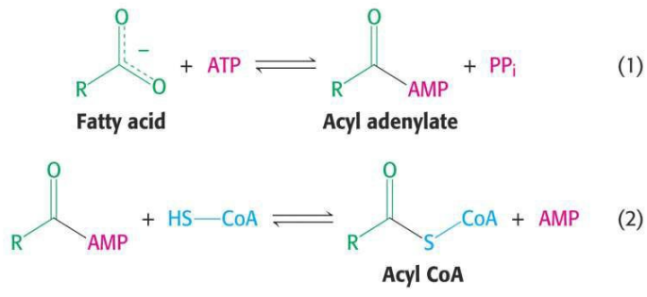
ACTIVATION OF FATTY ACIDS
Fatty acids must first be converted to an active intermediate before they can be catabolized. This is the only step in the complete degradation of a fatty acid that requires energy from ATP. The activation of a fatty acid is accomplished in two steps

Slide 10
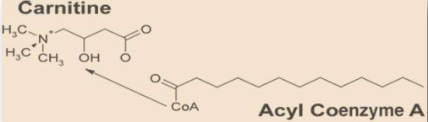
TRANSPORT OF FATTY ACID IN TO MITOCHONDRIAL MATRIX
Fatty acids are activated on the outer mitochondrial membrane, whereas they are oxidized in the mitochondrial matrix.
Activated long-chain fatty acids are transported across the membrane by conjugating them to carnitine, a zwitterionic alcohol.

Slide 11
TRANSPORT OF FATTY ACID IN TO MITOCHONDRIAL MATRIX
Carnitine (ß-hydroxy-Υ-trimethyl ammonium butyrate), (CH3 )3N+—CH2—CH(OH)—CH2—COO–, is widely distributed and is particularly abundant in muscle. Carnitine is obtained from foods, particularly animal-based foods, and via endogenous synthesis.

Slide 12
ROLE OF CARNITINE
1)The acyl group is to the hydroxyl group of carnitine to form acyl carnitine. This reaction is catalyzed by carnitine acyl transferase I
2)Acyl carnitine is then shuttled across the inner mitochondrial membrane by a translocase.
3)The acyl group is transferred back to CoA on the matrix side of the membrane. This reaction, which is catalyzed by carnitine acyl transferase II.
Finally, the translocase returns carnitine to the cytosolic side in exchange for an incoming acyl carnitine

Slide 13
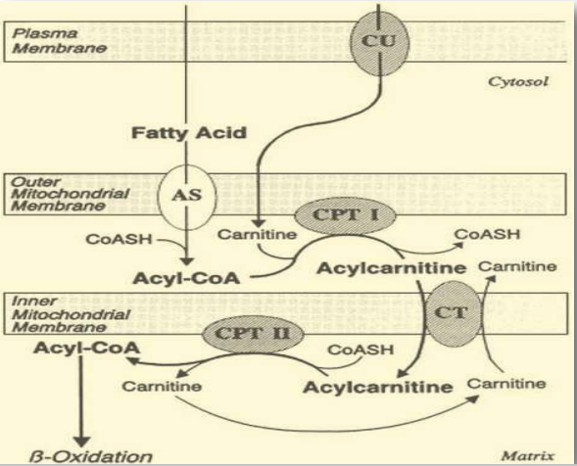
ROLE OF CARNITINE

Slide 14
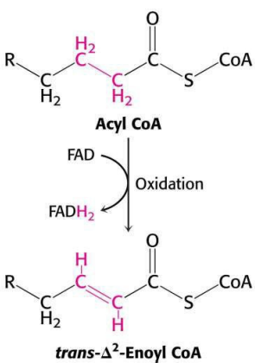
STEPS OF BETA OXIDATION
Step-1 Dehydrogenation - The first step is the removal o f two hydro g e n atoms from the 2(α ) - and 3(β ) - carbon atoms, catalyzed by acyl - CoA deh ydrogenase and requiring FAD. This results in the formation of Δ 2 -trans - enoyl-Co A and 16 FADH .

Slide 15
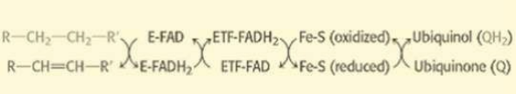
STEPS OF BETA OXIDATION
Electrons from the FADH2 prosthetic group of the reduced acyl CoA dehydrogenase are transferred to electron
transferring flavoprotein (ETF).
ETF donates electrons to ETF: ubiquinone reductase, an iron-sulfur protein.
Ubiquinone is thereby reduced to ubiquinol, which delivers its high-potential electrons to the second proton-pumping site of the respiratory

Slide 16
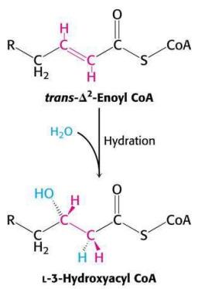
STEPS OF BETA OXIDATION
Step-2- Hydration Water is added to saturate the double bond and form 3 -hydroxyacyl-CoA, catalyzed by Δ 2-enoyl-CoA hydratase.

Slide 17
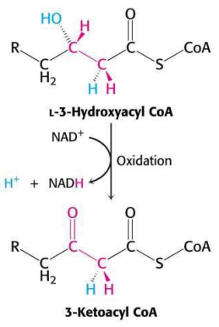
STEPS OF BETA OXIDATION
Step-3- dehydrogenationThe 3-hydroxy derivative undergoes further dehydrogenation on the 3-carbon catalyzed by L(+)-3-hydroxyacylCoA dehydrogenase to form the corresponding 3-ketoacyl-CoA compound. In this case, NAD+ is the coenzyme involved.

